Slide 1
Lexical Functional Grammar
AUTOMAT S18
Aquino, Kurt Neil
Esquillo, Lance Patrick
Ramos, Luis Angelo

Slide 2
In learning their native language, children develop a remarkable set of capabilities.
They acquire knowledge and skills that enable them to produce and comprehend understandable utterances as they grow, and make subtle judgments as they learn.

Slide 3
Introduction
Kaplan and Bresnan (1982) have adopted what they call the Competence Hypothesis as a methodological principle in order to formulate an explanatory conjecture of the mental operations that perform linguistic abilities.
In keeping with the Competence Hypothesis, the formalism called Lexical Functional Grammar (LFG) has been designed to serve as a medium for expressing and explaining important generalizations about the syntax of human languages and thus to serve as a vehicle for independent linguistic research.

Slide 4
Abstract
Lexical Functional Grammar (LFG) is a grammar framework in theoretical linguistics, and is one of the varieties of generative grammar.
LFG views language as being made up of multiple dimensions of structure.
Each of these dimensions is represented as a distinct structure with its own rules, concepts, and form.

Slide 5
Abstract
LFG assumes two different ways of representing syntactic structure, the constituent structure or c-structure and the functional structure or f-structure. These two structures constitute two subsystems of the overall system of linguistic structures.
Functional structure is the abstract functional syntactic organization of the sentence, familiar from traditional grammatical descriptions, representing syntactic predicate-argument structure and functional relations like subject and object.
Constituent structure is the overt, more concrete level of linear and hierarchical organization of words into phrases.

Slide 6
“Recent LFG work includes investigations of argument structure, semantic structure, and other linguistic structures and their relation to c-structure and f-structure.”

Slide 7
Formal Definition
Lexical-Functional Grammar (LFG) was first developed in the 1970’s by Joan Bresnan, a linguist at MIT, and Ron Kaplan, a psychologist at Harvard.
Bresnan and Kaplan were concerned with the related issues of psychological plausibility and computational tractability.
They wanted to create a theory that could form the basis of a realistic model for linguistic learnability and language processing.

Slide 8
Formal Definition – Lexicon
All the information that ends up in an f-structure starts out in the lexical entries of the words that compose the sentence.
This lexical entry says that love is a verb that means ‘love’, and takes two arguments, an obligatory subject and an obligatory object (as contained within the < > brackets).
The parentheses here do not mean “optional”, as both arguments are obligatory.
It also tells us that loves is the present tense form.
Finally it tells us that the subject is third person singular.
An example of a lexical entry for the verb “loves”:
loves: V (↑PRED) = ‘love <(↑SUBJ),( ↑OBJ)>’
(↑TENSE) = present
(↑SUBJ NUM) = sng
(↑SUBJ PERS) = 3rd

Slide 9
Formal Definition – Constituent Structures
Constituent structure encodes linear order, hierarchical groupings, and syntactic categories of constituents, and is the input to the phonological component of the grammar.
Examples of phrase structure rules for English:
S ——> NP VP
(↑ SUB) =↓ ↑=↓
VP ——> V NP
↑=↓ (↑ OBJ) =↓
The arrows are variables; ‘↑’ is to be instantiated by the node immediately dominating the constituent under which the arrow is placed, and ‘↓’ by that node itself.
So, the first equation for the rule on the left states that the NP under which the equation is written is the SUB of the S that dominates it.
The ‘↑=↓’ equation beneath VP indicates that the features of that node are shared with the higher node.

Slide 10
Formal Definition – Function
The notion of function is borrowed from mathematics and computer science. A function is a rule that maps from one item to another.
In LFG, grammatical functions are not defined by a tree; instead, they are primitive notions, meaning they cannot be derived. Every sentence has an f-structure that represents grammatical functions.
Grammatical functions are usually represented in what is called an Attribute Value Matrix (AVM); the item on the left is the attribute or function, the item on the right is the value attributed to that function:
Diana loves phonology.
[SUBJ [PRED3 ‘Diana’]]

Slide 11
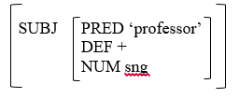
Formal Definition – Function
Attributes can have various kinds of values, including other AVMs. For example, the value for the SUBJ function in the following sentence is a matrix containing other functions:
The professor loves phonology.
the function PRED tells the lexical content of the subject NP
DEF tells you if it is definite or not
NUM tells you the number, etc.

Slide 12
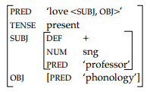
Formal Definition – Functional Structures
Functional Structures are the set of all the attribute value pairs for a sentence.
The professor loves phonology.
The topmost PRED function tells what the predicate of the sentence is.
It also contains information about the a-structure of the sentence.
The TENSE feature tells you about the tense of the sentence.
The SUBJ and OBJ functions have submatrices containing their respective values.

Slide 13
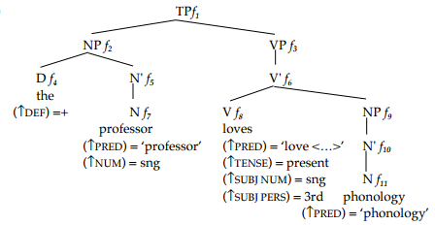
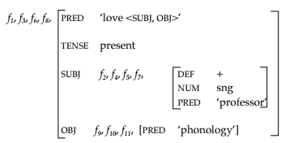
Formal Definition – Functional Structures
C-structures must be related to f-structures somehow. Each lexical item is followed by the information it contributes by virtue of its lexical entry.
Each of these variables corresponds to a pair of matrix brackets in the f-structure:
Multiple nodes in the tree can correspond to the same (sub) AVM:

Slide 14
Sample Applications
In addition to grammatical modularity, another underlying principle of LFG theory is that grammatical information grows monotonically (Bresnan, 2001), which means that it grows in an information-preserving manner.
LFG has a number of features that make it an attractive and useful framework for grammatical description, and for translation (Kroeger, 2007).

Slide 15
Sample Applications – IBM Watson: Jeopardy!
IBM Research undertook a challenge to build a computer system that could compete at the human champion level in real time on the American TV quiz show, Jeopardy.
Although LFG was not directly used, similar functions and structures, AI in the sense that both LFG and NLP covers generative grammar and grammar framework, were used for the generation of the AI.
The extent of the challenge includes fielding a real-time automatic contestant on the show, not merely a laboratory exercise.
After three years of intense research and development by a core team of about 20 researchers, Watson is performing at human expert levels in terms of precision, confidence, and speed at the Jeopardy quiz show.

